Slide 1
Practical Git Guide
Yura Zharkovsky
https://github.com/practicalgit
Notes:
1

Slide 2
Agenda
Motivation
Git Overview
Git Internals
GitHub
Practices

Slide 3
Motivation
Version Control
Backup
Collaboration
Distribution

Slide 4
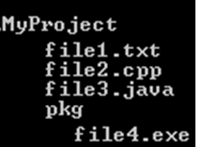
Motivation – Version Control
Auto generated file, should be ignored (excluded) during version control.
File2.cpp
(Ver 3)
File3.java
(Ver 2)
File4.exe
(Ver 1)
File1.txt
(Ver 6)
New file version contains:
Content
Change Date
Author
…..

Slide 5
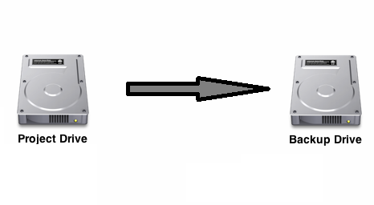
Motivation – Backup
Project with its sources should be copied to different folder (preferable to different disk)

Slide 6
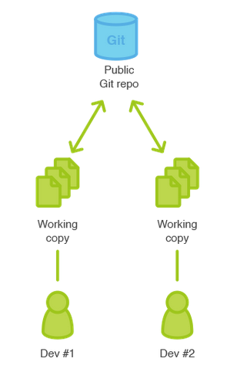
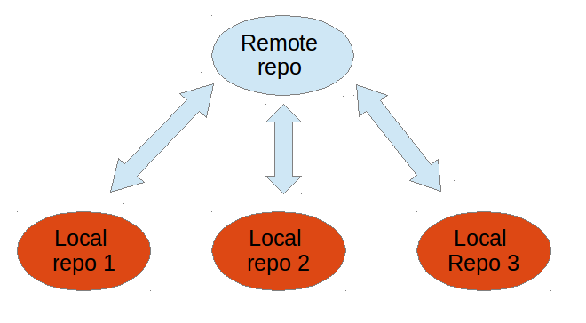
Motivation – Collaboration
Entire working directory part of it can be shared between developers
Version control and backup should be available even when remote repository is not reachable
Ability to synchronize remote repository with local repository (working directory)

Slide 7
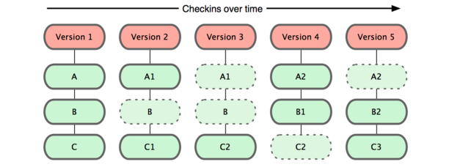
Motivation – Distribution
Alpha
Beta

Slide 8
Agenda
Motivation
Git Overview
Git Internals
GitHub
Practices

Slide 9
Git Overview
Git History
Git Version control System
Git adding to a Git repository
Git Snapshots
Git Distribution

Slide 10
Git Overview - History
As with many great things in life, Git began with a bit of creative destruction and fiery controversy.
The Linux kernel is an open source software project of fairly large scope. For most of the lifetime of the Linux kernel maintenance (1991–2002), changes to the software were passed around as patches and archived files.
In 2002, the Linux kernel project began using a proprietary DVCS called BitKeeper.
In 2005, the relationship between the community that developed the Linux kernel and the commercial company that developed BitKeeper broke down, and the tool’s free-of-charge status was revoked.
This prompted the Linux development community (and in particular Linus Torvalds, the creator of Linux) to develop their own tool based on some of the lessons they learned while using BitKeeper. Some of the goals of the new system were as follows:
Speed
Simple design
Strong support for non-linear development (thousands of parallel branches)
Fully distributed
Able to handle large projects like the Linux kernel efficiently (speed and data size)
Since its birth in 2005, Git has evolved and matured to be easy to use and yet retain these initial qualities. It’s incredibly fast, it’s very efficient with large projects, and it has an incredible branching system for non-linear development

Slide 11
Git Overview - Git point of view on any project’s files
Untracked files
Auto generated files
New files
Tracked files
Files which were added to git repository
Modified files
Tracked files which were locally modified
Ignored Files
Files which were marked as ignored

Slide 12
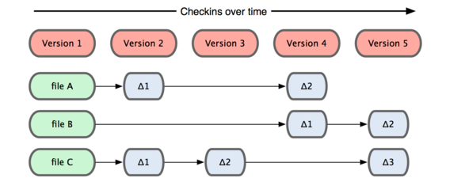
Git Overview - Snapshots not differences
Alpha
Beta

Slide 13
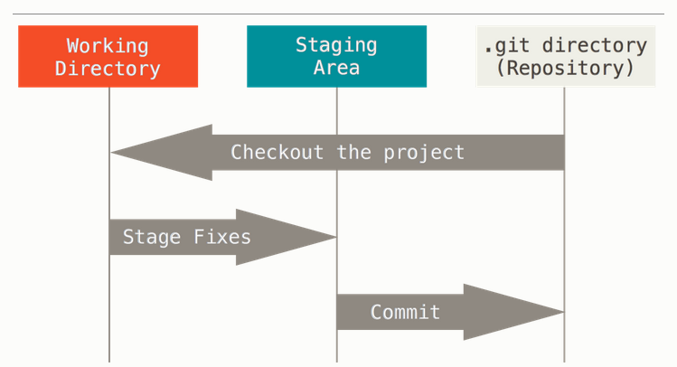
Git Overview – 3 states

Slide 14
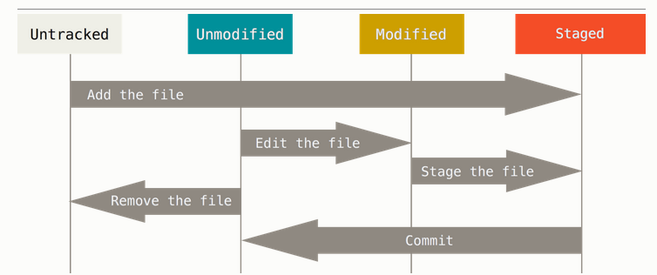
Git Overview – recording changes to the repository

Slide 15
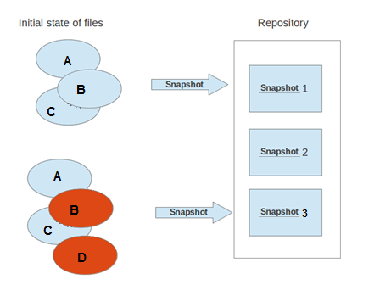
Git Overview - Snapshots (Commits)
MyProject
MyProject/.git
Untracked File
Snapshot
Tracked Files
E
Ignored File
Modified File
Untracked File

Slide 16
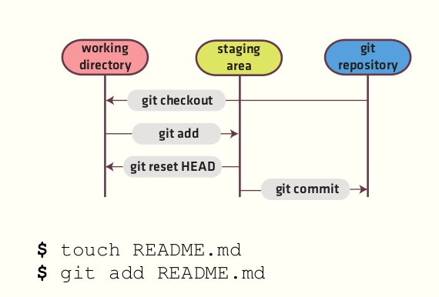
Git Overview - Adding to a Git repository
Indexed snapshot
Local snapshot
Git management resources (files, folders)
Committed snapshots
Snapshot 5
Snapshot 4
Snapshot 3
Snapshot 2
Initial Snapshot

Slide 17
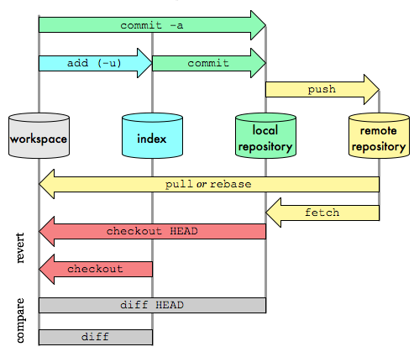
Git Overview - Data transport workflow

Slide 18
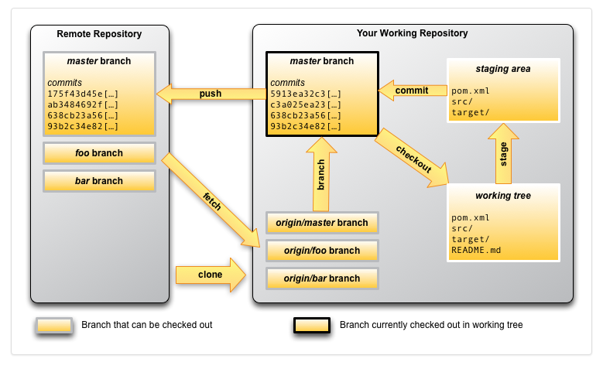
Git Overview - Workflow example

Slide 19
Git Overview - Summary of Git Terminology
Term | Definition
Branch | A branch is a named pointer to a commit. Selecting a branch in Git terminology is called to checkout a branch. If you are working in a certain branch, the creation of a new commit advances this pointer to the newly created commit. Each commit knows their parents (predecessors). Successors are retrieved by traversing the commit graph starting from branches or other refs, symbolic references (for example: HEAD) or explicit commit objects. This way a branch defines its own line of descendants in the overall version graph formed by all commits in the repository. You can create a new branch from an existing one and change the code independently from other branches. One of the branches is the default (typically named master). The default branch is the one for which a local branch is automatically created when cloning the repository.
Commit | When you commit your changes into a repository this creates a new commit object in the Git repository. This commit object uniquely identifies a new revision of the content of the repository. This revision can be retrieved later, for example, if you want to see the source code of an older version. Each commit object contains the author and the committer, thus making it possible to identify who did the change. The author and committer might be different people. The author did the change and the committer applied the change to the Git repository. This is common for contributions to open source projects.
HEAD | HEAD is a symbolic reference most often pointing to the currently checked out branch. Sometimes the HEAD points directly to a commit object, this is called detached HEAD mode. In that state creation of a commit will not move any branch. If you switch branches, the HEAD pointer points to the branch pointer which in turn points to a commit. If you checkout a specific commit, the HEAD points to this commit directly.
Index | Index is an alternative term for the staging area.
Working tree | The working tree contains the set of working files for the repository. You can modify the content and commit the changes as new commits to the repository.

Slide 20
Git Overview - Summary of Git Terminology
Term | Definition
Repository | A repository contains the history, the different versions over time and all different branches and tags. In Git each copy of the repository is a complete repository. If the repository is not a bare repository, it allows you to checkout revisions into your working tree and to capture changes by creating new commits. Bare repositories are only changed by transporting changes from other repositories. This book uses the term repository to talk about a non-bare repository. If it talks about a bare repository, this is explicitly mentioned.
Revision | Represents a version of the source code. Git implements revisions as commit objects (or short commits). These are identified by an SHA-1 hash.
Staging area | The staging area is the place to store changes in the working tree before the commit. The staging area contains a snapshot of the changes in the working tree (changed or new files) relevant to create the next commit and stores their mode (file type, executable bit).
Tag | A tag points to a commit which uniquely identifies a version of the Git repository. With a tag, you can have a named point to which you can always revert to. You can revert to any point in a Git repository, but tags make it easier. The benefit of tags is to mark the repository for a specific reason, e.g., with a release. Branches and tags are named pointers, the difference is that branches move when a new commit is created while tags always point to the same commit. Tags can have a timestamp and a message associated with them.
URL | A URL in Git determines the location of the repository. Git distinguishes between fetchurl for getting new data from other repositories and pushurl for pushing data to another repository.

Slide 21
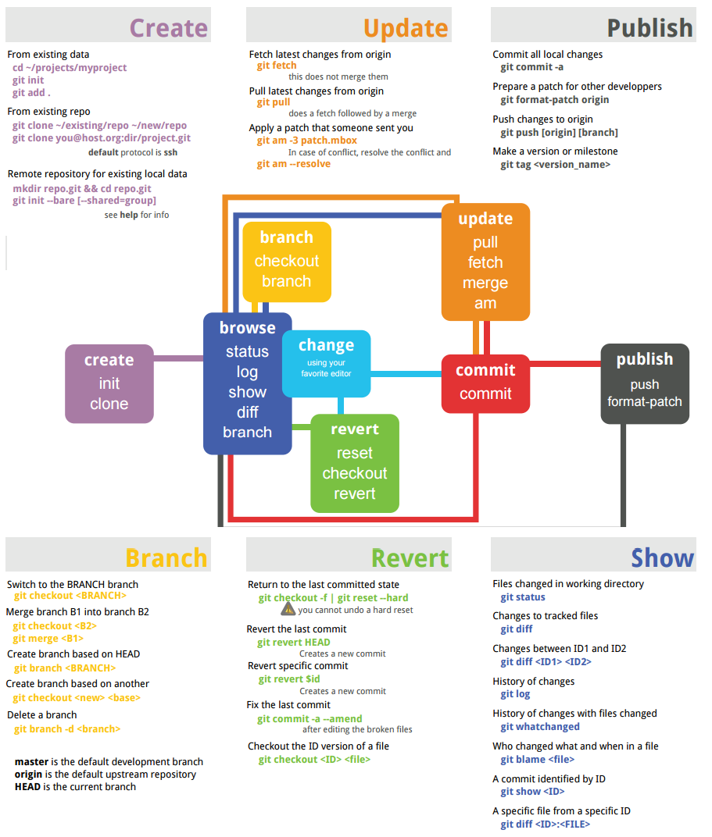
Git Overview - Commands

Slide 22
Agenda
Motivation
Git Overview
Git Internals
GitHub
Practices

Slide 23
Git Internals
.git Folder
What is Trees and Blobs really ?
What is Commit really ?
What is Branch really ?
What is Tag really ?

Slide 24
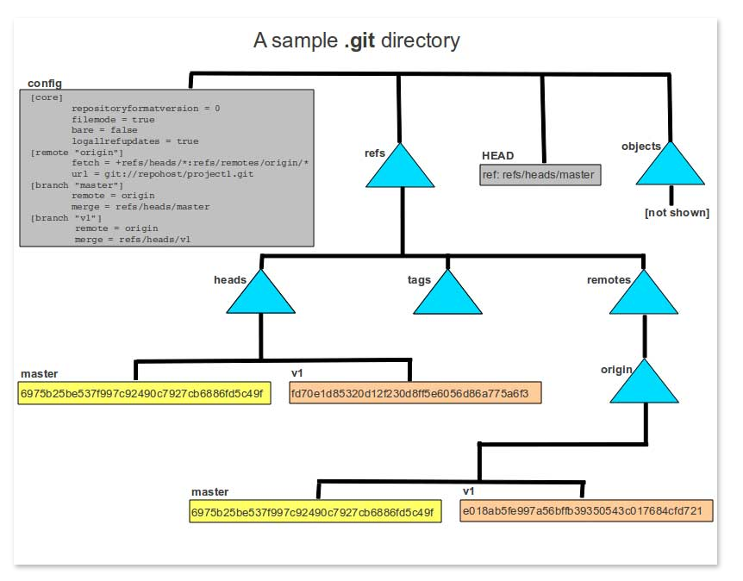
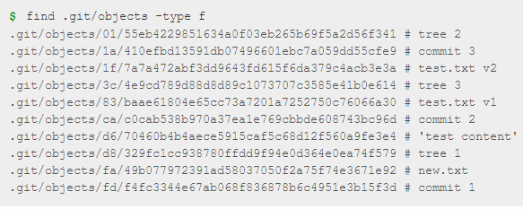
Git Internals - .git

Slide 25
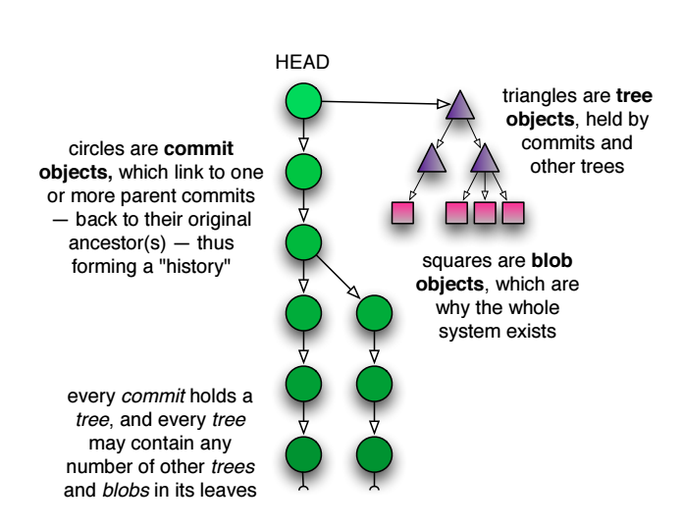
Git Internals – What is Trees and Blobs really ?

Slide 26
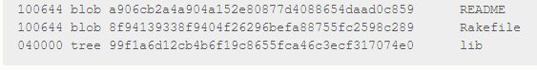
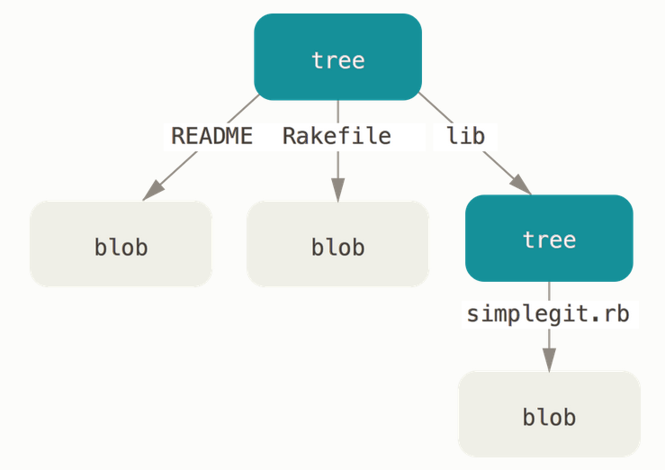
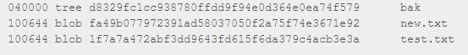
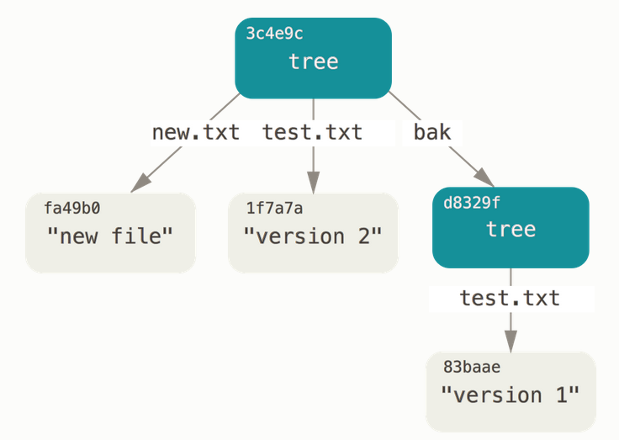
Git Internals – What is Trees and Blobs really ?
Tree: represent directory
Blob: corresponds to file content

Slide 27
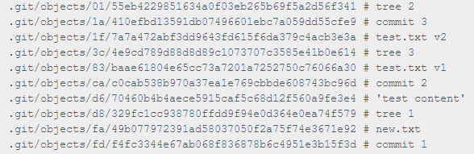
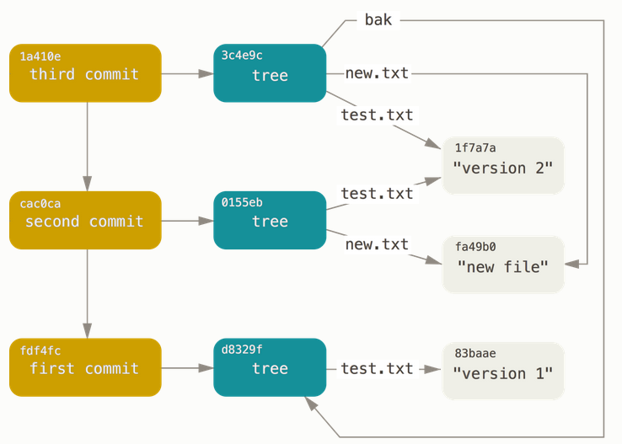
Git Internals – What is Commit really ?

Slide 28
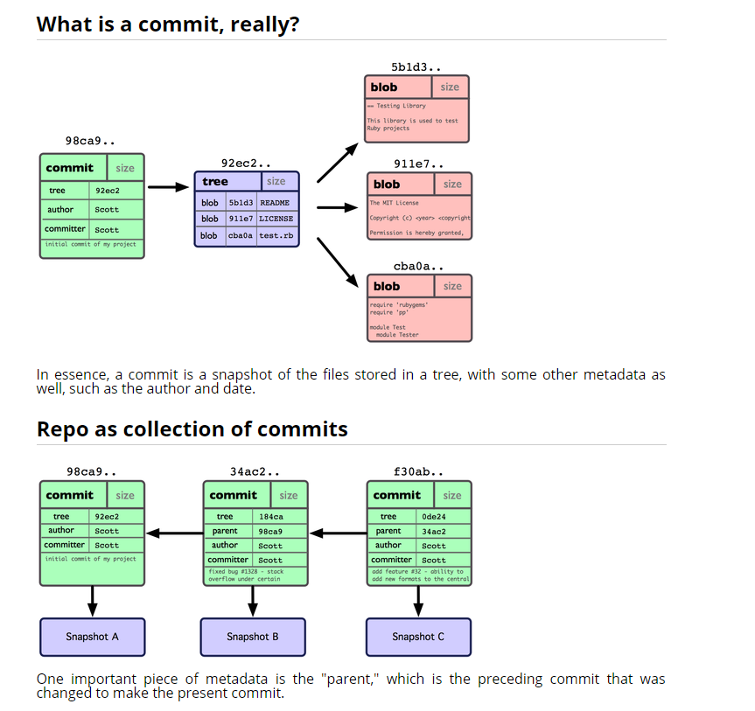
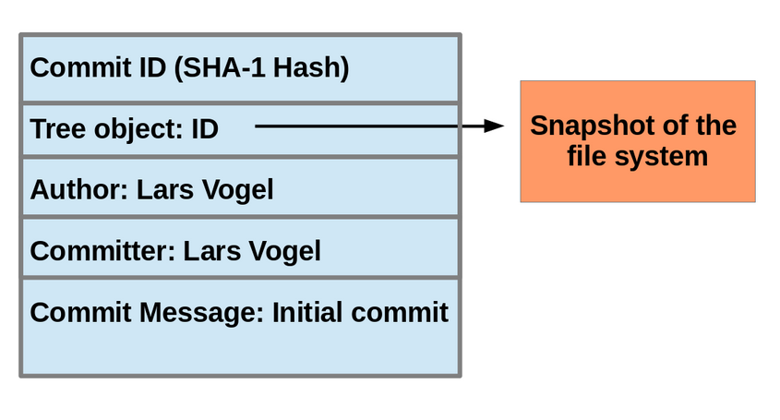
Git Internals - What is Commit really ?
Snapshot = Commit

Slide 29
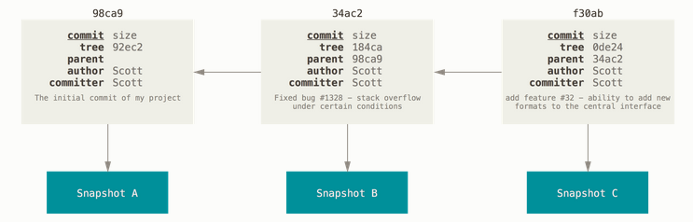
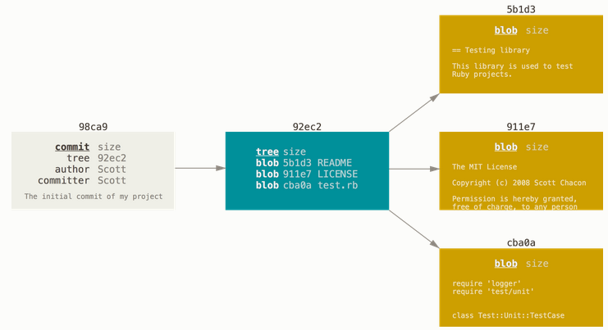
Git Internals – What is Commit really ?

Slide 30
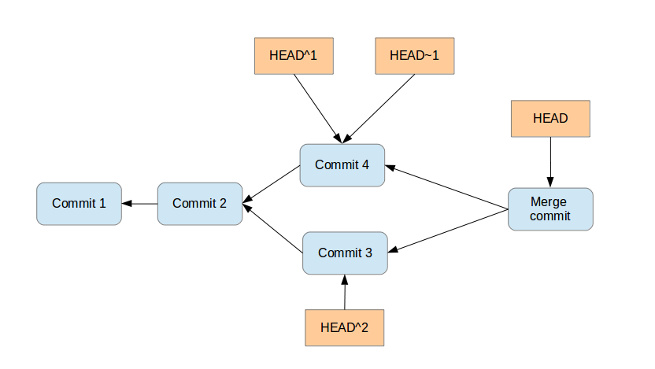
Git Internals - What is Commit really ?
Each commit has zero or more direct predecessor commits. The first commit has zero parents, merge commits have two or more parents, most commits have one parent.
You can use ^ (caret) and ~ (tilde) to reference predecessor commit objects from other references. You can also combine the ^ and ~ operators
HEAD~3
experiment
master
A branch points to a specific commit.
You can use the branch name as reference to the corresponding commit.
You can also use HEAD to reference the corresponding commit.

Slide 31
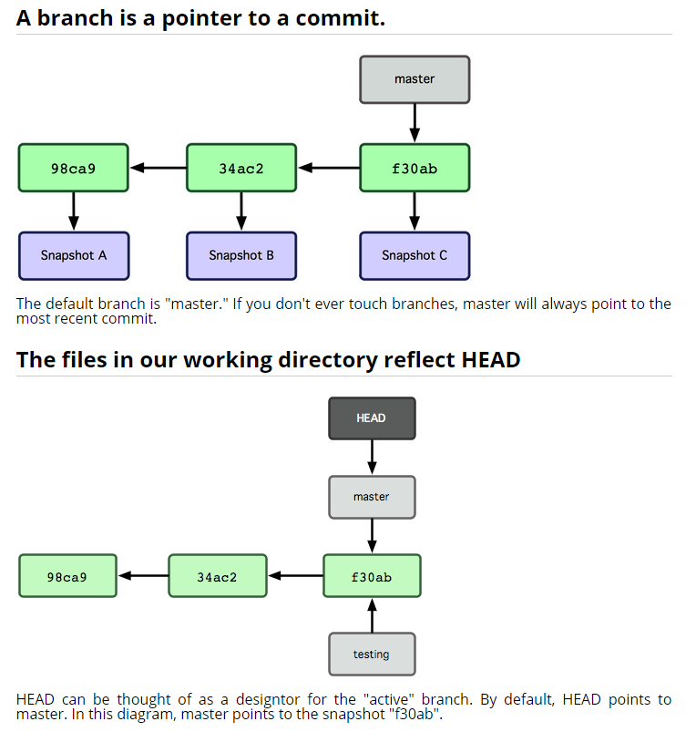
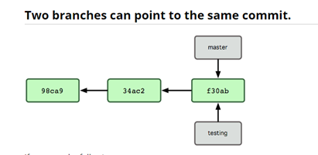
Git Internals - What is Branch really ?

Slide 32
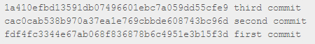
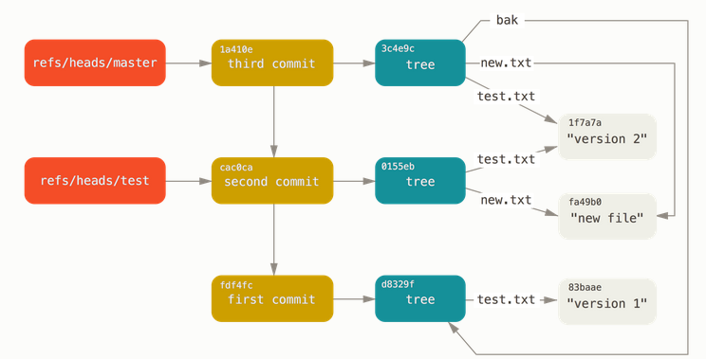
Git Internals – What is Branch really ?

Slide 33
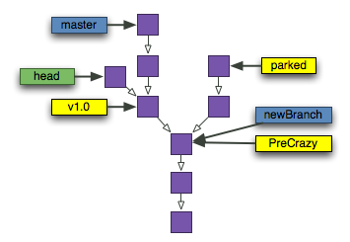
Git Internals – What is Tag really ?

Slide 34
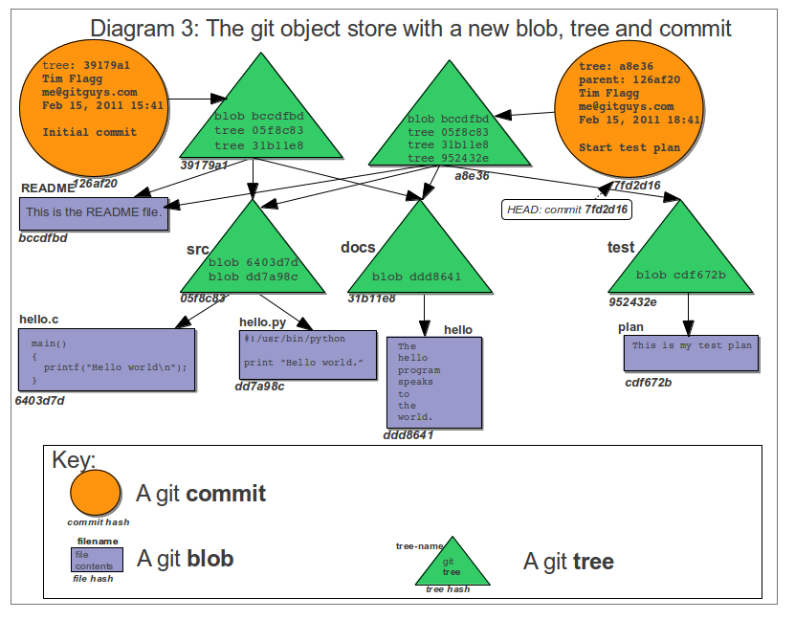
Git Internals – What is Tag really ?

Slide 35
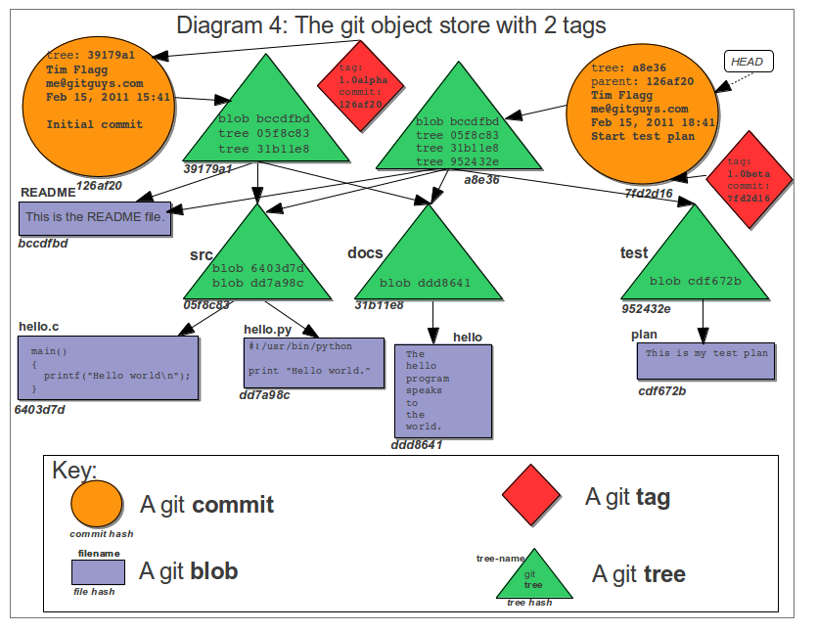
Git Internals – What is Tag really ?

Slide 36
Agenda
Motivation
Git Overview
Git Internals
GitHub
Practices

Slide 37
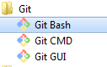
GitHub : Set Up Git
Open “Set Up Git” : https://help.github.com/articles/set-up-git/
Download and install Git: https://git-scm.com/downloads
On your computer, open the Git Bash application.
Tell Git your name so your commits will be properly labeled.
git config --global user.name "YOUR NAME“
Tell Git the email address that will be associated with your Git commits.
git config --global user.email "YOUR EMAIL ADDRESS"
When you connect to a GitHub repository from Git, you'll need to authenticate with GitHub using either HTTPS or SSH.
Generating SSH keys: https://help.github.com/articles/generating-ssh-keys/
Cloning with SSH
These URLs provide access to a Git repository via SSH, which is a secure protocol. To use these URLs, you must have an SSH keypair generated on your computer, and attached to your GitHub account.
The GitHub desktop clients automatically configure SSH keys for you, if you don't want to muck around on the command line.

Slide 38
GitHub: Generating SSH keys
Follow steps on : https://help.github.com/articles/generating-ssh-keys/
Summary (windows):
Generate a new SSH key:
ssh-keygen -t rsa -b 4096 -C `email address`
Add your key to the ssh-agent
eval `ssh-agent -s`
ssh-add ~/.ssh/id_rsa
Add your SSH key to your account
Copy to clipboard: clip < ~/.ssh/id_rsa.pub
Paste to github
Test the connection
ssh -T git@github.com

Slide 39
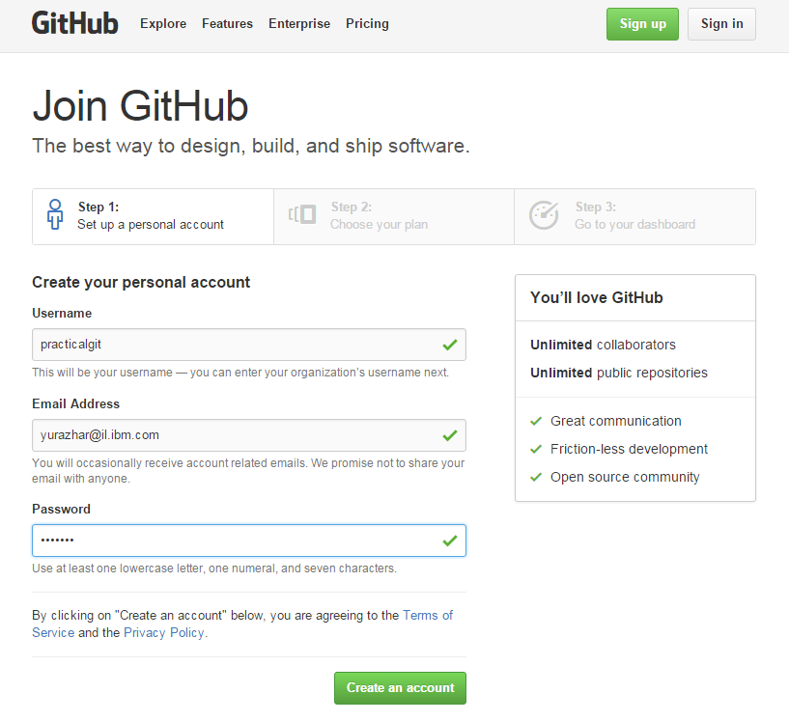
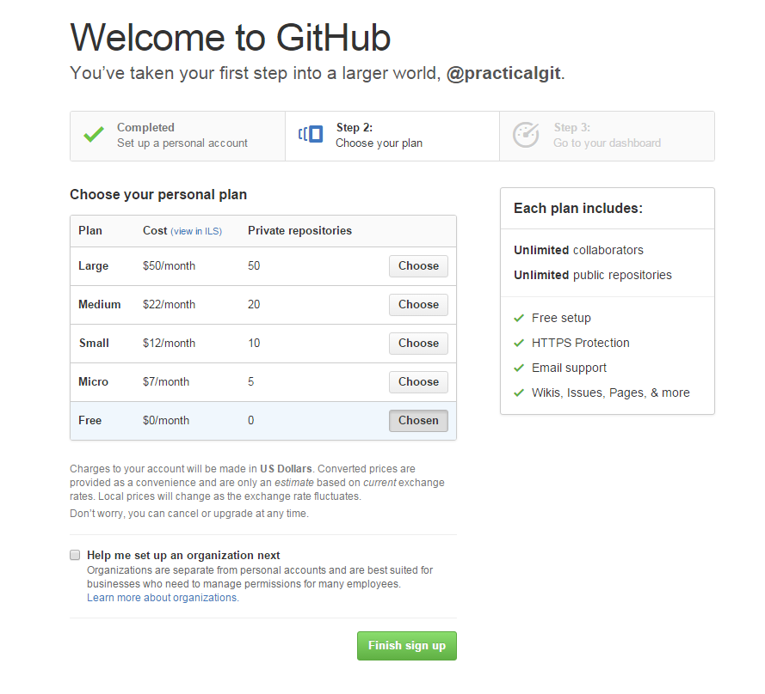
GitHub : Creating Account
Browse to GitHub site: https://github.com/
Sign Up: https://github.com/join
Learn more about GitHub: https://help.github.com/
GitHuB: Powerful collaboration, code review, and code management for
open source and private projects. Public projects are always free.

Slide 40
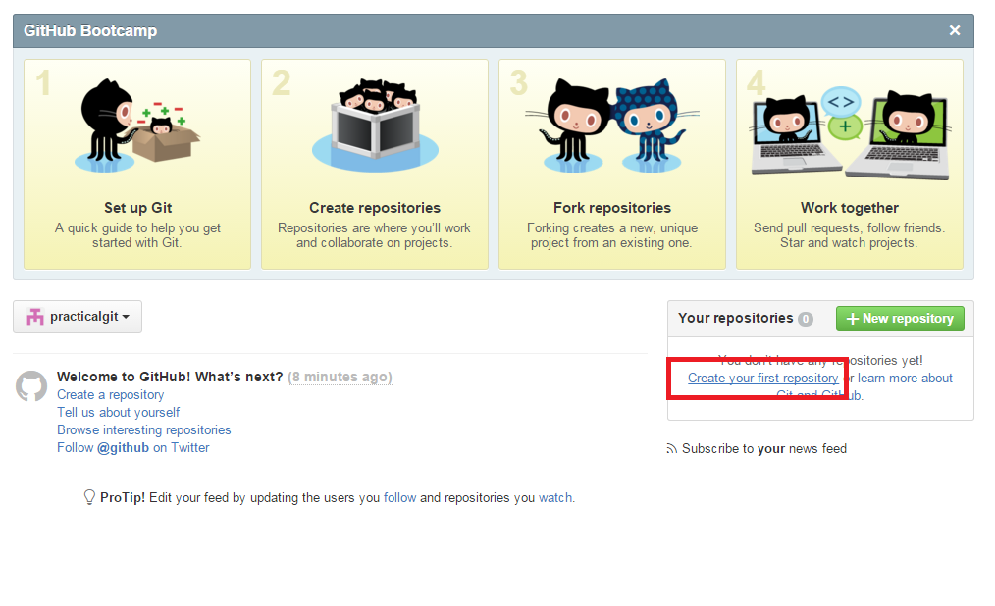
GitHub : Verifying Account
Before you can contribute on GitHub, GitHuB needs you to verify your email address.
An email containing verification instructions will be sent to your email.
Verify your email address and continue to create your first repository

Slide 41
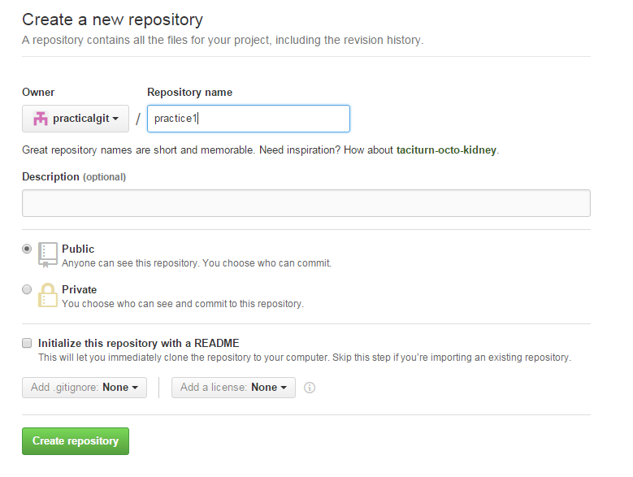
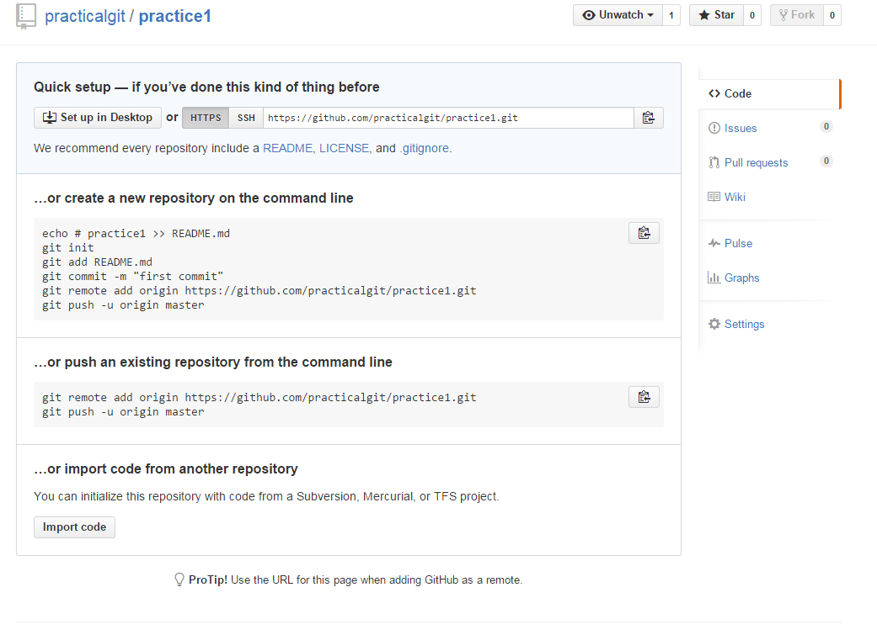
GitHub: Creating first repository
Select this option to initialize repository with default master branch (even if you don’t need readme file)

Slide 42
Agenda
Motivation
Git Overview
Git Internals
GitHub
Practices

Slide 43
Practice 1: Introduction
mkdir practice1
cd practice1
echo “This is my first file.” > myfile.txt
git init
ls .git # A look at what we've done.
git add . # same as git add myfile.txt
git commit -m “Initial commit.”
git log # show all commits
echo "This is my second file." > myfile2.txt
git status # UNTRACKED
git add myfile2.txt
git status # STAGED
echo "A change to this file." >> myfile2.txt # MODIFIED
git status # STAGED *and* MODIFIED
git diff # Diff between working directory vs staged changes
git diff --cached # Diff between staged changes vs. commit
git commit -m "Any guess what gets committed here?"
git status
Here, we set up a new git repo, add a file, and commit project to the repository.
Here we'll create a new file. All files start out untracked. When we add it with "git add," it becomes staged, ready to be committed.
If we modify the file, our new changes aren't staged yet.
A commit at this point will commit the file as it was when we added it, without the later changes.

Slide 44
Practice 2: Introduction
echo "Forgot this file!" > forgot.txt
git status
git add forgot.txt
git log --name-only # notice last commit message and files
git commit --amend -m "Here's a replacement commit message."
git log --name-only # notice last commit message and files
echo "Don't really need this line." > myfile.txt
git add myfile.txt
git status
git reset HEAD myfile.txt # Unstage.
git status
git checkout myfile.txt # Delete change.
git status
git checkout -- . #to discard changes in working directory
Oops! We made a mistake there, by not adding our new changes into the commit. Fortunately for us, git can rewrite history! If we commit those changes with the "--amend" option, we're actually changing the last commit. We can also change its commit message.
What if we accidentally stage something, we can unstage it with git reset. If we have untracked changes to a file that we want to discard, we can reset that file with git checkout. Bear in mind, you will lose those changes forever if you do this!

Slide 45
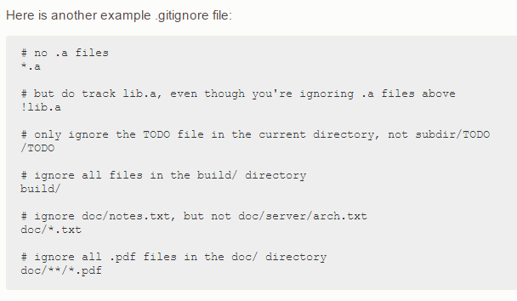
Practice 3: Recording Changes to the Repository
git init practice3
cd practice3
echo “auto generated” > auto_generated.exe
echo “auto_generated.exe” > .gitignore
mkdir dir1 # create new local directory
echo “dir1” >> .gitignore
cat .gitignore # show the content
echo “A” > a.txt
echo “B” > b.txt
git status # determine which files are in which state
git add –A # track new files which are not ignored
git status –s # a far more simplified status output
git diff # compares working directory with staging area
git diff --staged # compares staged with your next commit
git diff --cached # same as staged
git commit –m “commit 1”
Summary:
git add -A stages All
git add . stages new and modified, without deleted
git add -u stages modified and deleted, without new

Slide 46
Practice 4: Git Aliases
git config --global alias.co checkout
git config --global alias.br branch
git config --global alias.ci commit
git config --global alias.st status
git config --global alias.unstage ‘reset HEAD –’ # remove from index
echo “D” > d.txt; git add .
git status # d.txt staged (added to index)
git unstage d.txt
git status # d.txt untracked
git reset HEAD – d.txt
git config --global alias.last 'log -1 HEAD‘ # show last commit
git last
git config --global alias.visual '!gitk‘
git visual
git config --global alias.lg ‘log --oneline --decorate --graph --all’
git config --global alias.changed ‘show --pretty="format:" --name-only’
Git doesn’t automatically infer your command if you type it in partially. If you don’t want to type the entire text of each of the Git commands, you can easily set up an alias for each command using git config. Here are a couple of examples you may want to set up:
Alias makes the following two commands equivalent

Slide 47
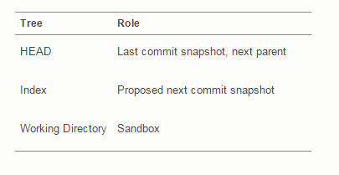
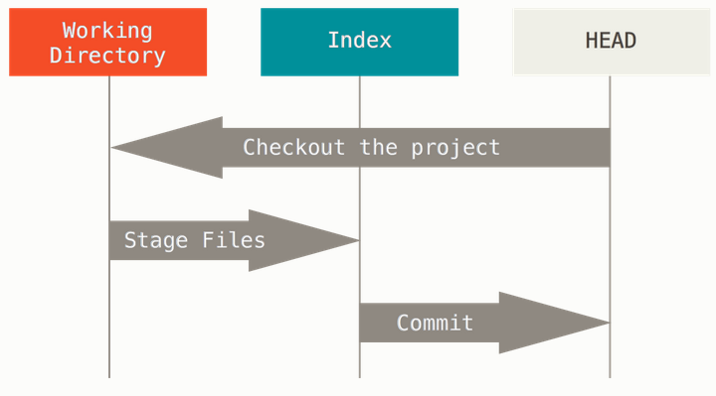
Practice 5: Reset Demystified
git init myproject5
cd myproject
echo “A" > a.txt; git add .; git commit -m “A“
echo “B" > b.txt; git add .; git commit -m “B“
# examine what specific snapshot looks like
git cat-file -p HEAD
git ls-tree -r HEAD
git ls-files -s

Slide 48
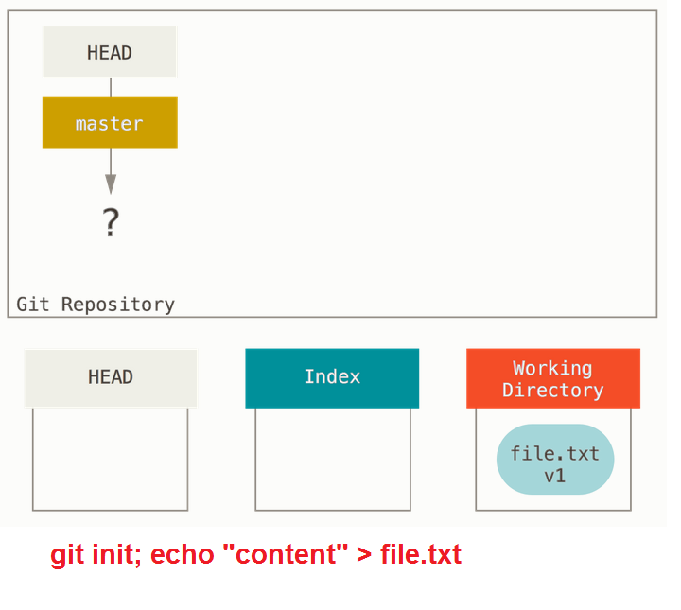
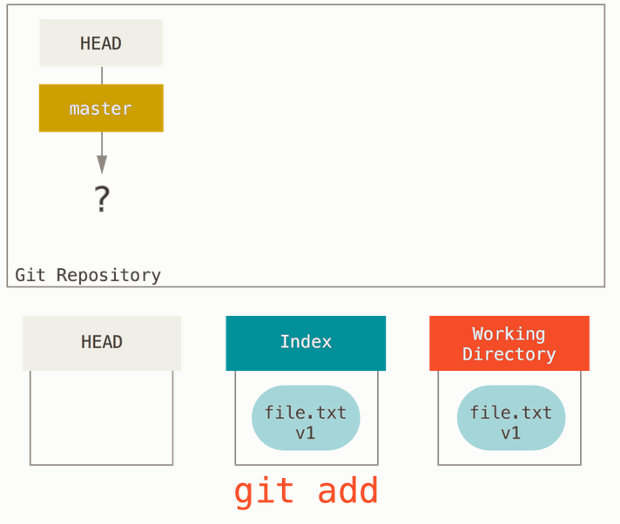
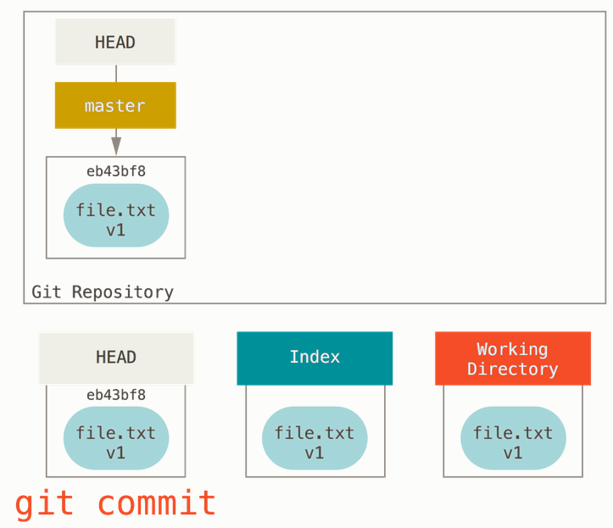
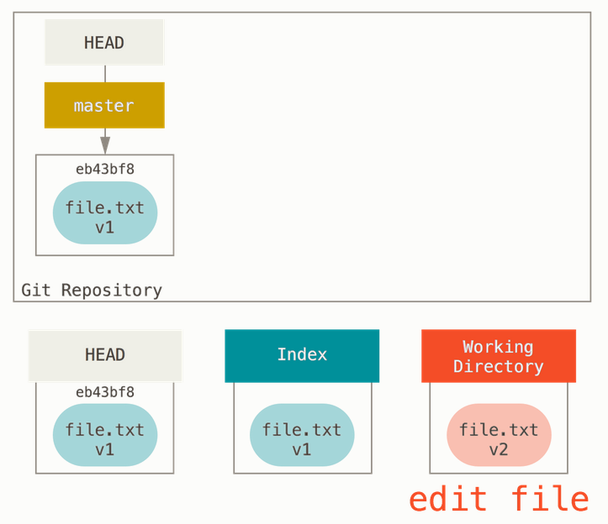
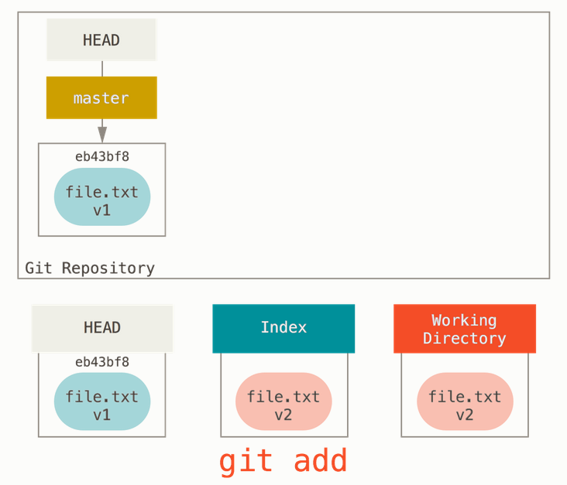
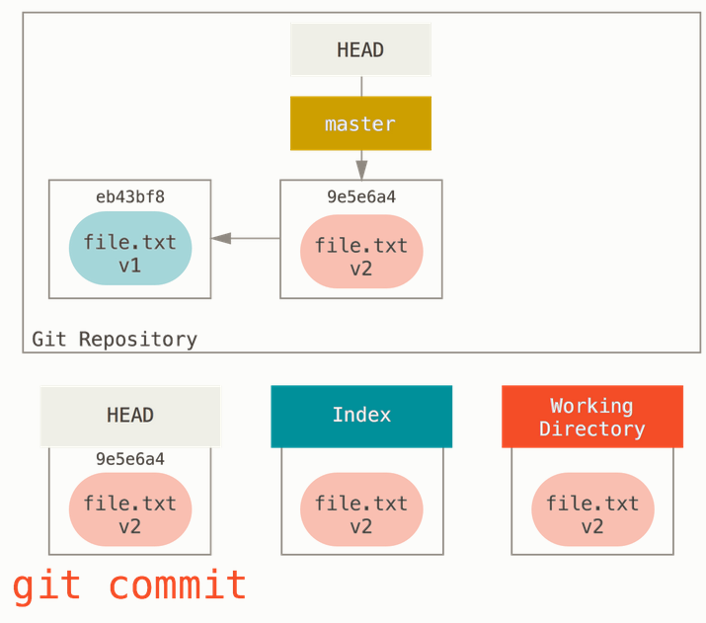
Practice 6: Reset Demystified

Slide 49
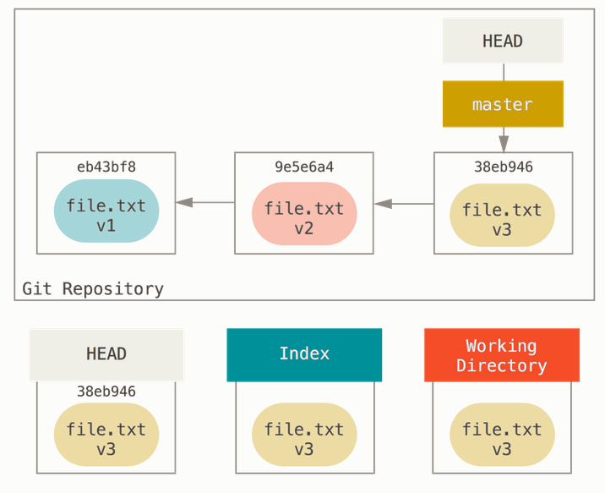



Practice 6: Reset Demystified

Slide 50




Practice 6: Reset Demystified
git reset --mixed HEAD file.txt
This has the practical effect of unstaging the file. If we look at the diagram for that command and think about what git add does, they are exact opposites

Slide 51

Practice 7: Squashing
git init myproject7
cd myproject7
echo “A" > a.txt; git add .; git commit -m “A“
echo “B" > b.txt; git add .; git commit -m “B“
echo “C" > b.txt; git add .; git commit -m “C“
git rebase -i HEAD~3
git commit –amend
git rebase --continue
git log –oneline
git log --pretty=format:"%h %s" HEAD~3..HEAD

Slide 52



Practice 8: Branching
If you make some changes and commit again, the next commit stores a pointer to the commit that came immediately before it.

Slide 53

Practice 8: Branching
A branch in Git is simply a lightweight movable pointer to one of these commits. The default branch name in Git is master. As you start making commits, you’re given a master branch that points to the last commit you made. Every time you commit, it moves forward automatically.
The “master” branch in Git is not a special branch. It is exactly like any other branch. The only reason nearly every repository has one is that the git init command creates it by default and most people don’t bother to change it.

Slide 54


Practice 8: Branching
git branch testing
This creates a new pointer at the same commit you’re currently on.
How does Git know what branch you’re currently on? It keeps a special pointer called HEAD. Note that this is a lot different than the concept of HEAD in other VCSs you may be used to, such as Subversion or CVS. In Git, this is a pointer to the local branch you’re currently on. In this case, you’re still on master. The git branch command only created a new branch – it didn’t switch to that branch.

Slide 55


Practice 8: Branching
git checkout testing
This moves HEAD to point to the testing branch
touch somefile.txt
git commit -a –m ‘made a change’

Slide 56


Practice 8: Branching
git checkout master
That command did two things. It moved the HEAD pointer back to point to the master branch, and it reverted the files in your working directory back to the snapshot that master points to. This also means the changes you make from this point forward will diverge from an older version of the project. It essentially rewinds the work you’ve done in your testing branch so you can go in a different direction.
touch somefile.txt
git commit -a –m ‘made additional change’
git log --oneline --decorate --graph --all

Slide 57

Practice 9: Branch Management
# use last practice project
git branch # get a simple listing of the current branches
git branch -v # To see the last commit on each branch
git branch --merged # Branches which are already merged into the current branch
git branch -b testing # create new branch
git branch --no-merged # all the branches that contain work you haven’t yet merged in
git branch -d testing # delete branch
Notice the * character that prefixes the master branch: it indicates the branch that you currently have checked out (i.e., the branch that HEAD points to).
Ex: Branches which were previously merged and they are without the * in front of them are generally fine to delete with git branch -d; you’ve already incorporated their work into another branch, so you’re not going to lose anything.

Slide 58


Practice 10: Basic Merging
git init practice10
cd practice10
echo “C0" > f.txt; git add .; git commit -m “C0“
echo “C1" > f.txt; git add .; git commit -m “C1“
echo "C2" > f.txt; git add .; git commit -m "C2“
git checkout -b iss53 # shorthand: git branch iss53; git checkout iss53
git lg # see aliases section
echo "C3" >> f.txt; git add .; git commit -m "C3“
echo "C5" >> f.txt; git add .; git commit -m "C5“
git checkout master
git lg # see aliases section
echo "C4" > f.txt; git add .; git commit -m "C4“
git merge iss53 # merge conflict appears
git status
git lg # see aliases section
# Resolve merge conflicts by editing f.txt file
git commit –am “C5”
git lg
git branch -d iss53 # only if this branch is temporary and not needed any more

Slide 59




Practice 11: Rebase
The easiest way to integrate the branches, as is the merge command. It performs a three-way merge between the two latest branch snapshots (C3 and C4) and the most recent common ancestor of the two (C2), creating a new snapshot (and commit).
However, there is another way: you can take the patch of the change that was introduced in C4 and reapply it on top of C3. In Git, this is called rebasing. With the rebase command, you can take all the changes that were committed on one branch and replay them on another one.
It works by going to the common ancestor of the two branches (the one you’re on and the one you’re rebasing onto), getting the diff introduced by each commit of the branch you’re on, saving those diffs to temporary files, resetting the current branch to the same commit as the branch you are rebasing onto, and finally applying each change in turn.

Slide 60
Practice 11: Rebase
# Create new project with 4 commits (C0,C1,C2,C3,C4) and 2 branches (master, experiment)
# take all the changes that were committed on experiment branch and replay them on master one
git checkout experiment
git rebase master
git lg
# go back to the master branch and do a fast-forward merge
git checkout master
git merge experiment
git lg

Slide 61



Practice 12: More interesting Rebase
# Create new project with 10 commits (C0,…,C10) and 3 branches (master, server, client)
# Merge client’s commits (C8, C9) onto master without server’s commits (C3, C4, C10)
git checkout client
git rebase --onto master server client
# go back to the master branch and do a fast-forward merge
git checkout master
git merge client
Merge your client-side changes into your mainline for a release, but hold off on the server-side changes until it’s tested further. You can take the changes on client that aren’t on server (C8 and C9) and replay them on your master branch by using the --onto option of git rebase:

Slide 62


Practice 12: More interesting Rebase
git rebase master server # replays your server work on top of your master
# go back to the master branch and do a fast-forward merge
git checkout master
git merge server
# You can remove the client and server branches because all the work is integrated and you don’t need them anymore
git branch -d client
git branch -d server

Slide 63

Practice 13: Commit References
git init practice13 # Create an empty Git repository
cd practice13
git commit --allow-empty -m “Commit 1“ # Create empty commit
git log --oneline --decorate --graph --all# Display commits
git commit --allow-empty -m “Commit 2“ # Create empty commit
git log --oneline --decorate --graph --all# Display commits
git checkout -b temp_branch # create new temporary branch
git log --oneline --decorate --graph --all# Display commits
git commit --allow-empty -m “Commit 3“ # Create empty commit
git log --oneline --decorate --graph --all# Display commits
git checkout master # switch back to master
git log --oneline --decorate --graph --all# Display commits
git commit --allow-empty -m “Commit 4“ # Create empty commit
git log --oneline --decorate --graph --all# Display commits
git merge temp_branch – m “merge 3,4” # merge temporary branch to master
git log --oneline --decorate --graph --all# Display commits
git branch -d temp_branch # delete temporary branch
git log --oneline --decorate --graph --all# Display commits
git log HEAD
git log HEAD~ # same as HEAD~1
git log HEAD~1 # first predecessor of the commit object
git log HEAD~2 # first predecessor of the first predecessor
git log HEAD^1 # describes the first predecessor of the commit object
git log HEAD^2 # describes the second predecessor
git log HEAD~2.. HEAD # All commits between HEAD and HEAD~2
master
You can also specify ranges of commits. This is useful for certain Git commands, for example, for seeing the changes between a series of commits.
The double dot operator allows you to select all commits which are reachable from a commit c2 but not from commit c1. The syntax for this is "c1..c2". A commit A is reachable from another commit B if A is a direct or indirect parent of B.

Slide 64

Practice 14: Getting Git Repository
Create a new remote repository and populate it with a local project
See GitHub slides
For example: git@github.com:practicalgit/practice4.git
# scenario 1: create a new repository on the command line
git init practice14 # name project with unique name
cd practice14
echo “content” >> README
git add README
git commit -m "first commit“
# Create remote EMPTY repository
git remote add origin git@github.com:practicalgit/practice4.git
git push -u origin master # allows to invoke git pull or git fetch
cd ..
rm –rf practice4
# scenario 2: clone a repository from the command line
# make sure to use SSH link not HTTPS
git clone git@github.com:practicalgit/practice4.git
cd practice4
git push -u origin master
Is the same as:
git push origin master ; git branch --set-upstream master origin/master
It means that local master branch it tracking remote origin/master branch.

Slide 65
Practice 15: Working with Remotes
git init practice15
cd practice15
git remote add origin git@github.com:practicalgit/practice5.git
git remote # shows remote repositories short names
echo “A” > a.txt
git add a.txt
git commit –m “Commit for master”
git push -u origin master
git checkout –b testing
echo “B” > b.txt
git add b.txt
git commit –m “Commit for testing”
git push origin testing
git log --oneline --decorate --graph --all # Display commits
git branch –r # shows remotes branches
git remote –v # shows you the URLs for reading and writing to that remote:
# create the additional alias to remote repository
git remote add experiment git@github.com:practicalgit/practice4.git
git remote –v
git pull experiment master # pull experiment repository and merge
git log --oneline --decorate --graph --all # Display commits
git remote show origin # inspect repository
git remote show experiment
git remote rename experiment bigbang # rename remote repository
git remote

Slide 66
Practice 16: Tags
# create new repository on GitHub (practice6) and a new local project
git init practice16
cd practice16
git remote add origin git@github.com:practicalgit/practice6.git
echo "A" > a.txt; git add .; git commit -m “A“
echo “B" > b.txt; git add .; git commit -m “B“
echo "C" > c.txt; git add .; git commit -m "C“
git push –u origin master
git log --oneline --decorate --graph --all # Display commits
git tag –a v1.4 –m ‘version 1.4’ # create annotated tag
git show v1.4
git tag v1.4.1 # create lightweight tag
git tag
git log --pretty=oneline
git tag -a v1.2 9fceb02 # tag specific commit
git push origin v1.4 # share specific tag
# see GitHub releases
git push origin --tags # transfer all of your tags to the remote server
# see GitHub releases
Git uses two main types of tags: lightweight and annotated.
lightweight tag is very much like a branch that doesn’t change – it’s just a pointer to a specific commit.
Annotated tags, however, are stored as full objects in the Git database. They’re check summed; contain the tagger name, email, and date; have a tagging message; and can be signed and verified with GNU Privacy Guard (GPG). It’s generally recommended that you create annotated tags so you can have all this information; but if you want a temporary tag or for some reason don’t want to keep the other information, lightweight tags are available too.
Now, suppose you forgot to tag the project at v1.2, which was at specific commit. You can add it after the fact. To tag that commit, you specify the commit checksum (or part of it) at the end of the command:

Slide 67
Practice 17: Stashing and Cleaning
git init myproject17
cd myproject17
echo “A" > a.txt; git add .; git commit -m “A“
echo “B" > b.txt; git add .
echo “C“ > c.txt
git status
git lg
git stash # push a new stash onto your stack and clean working directory
git status
git stash list # examine which stashes you’ve stored
echo “D" > d.txt; git add .
git stash
git status
git stash list
git stash apply # reapply the one you just stashed
git stash apply stash@{1} # apply one of the older stashes
git stash apply –index
git stash drop stash@{0} # remove stash
git stash –u # stash the untracked files as well as the tracked ones
git stash branch experiment # recover stashed work easily and work on it in a new branch
git clean # remove files from your working directory that are not tracked
git clean -f –d # removes any files and also any subdirectories
git stash --all# remove everything but save it in a stash
git status -s
Stashing takes the dirty state of your working directory – that is, your modified tracked files and staged changes – and saves it on a stack of unfinished changes that you can reapply at any time.
Now you want to switch branches, but you don’t want to commit what you’ve been working on yet; so you’ll stash the changes.
At this point, you can easily switch branches and do work elsewhere
The changes to your files were reapplied, but the file you staged before wasn’t restaged. To do that, you must run the git stash apply command with a --index option to tell the command to try to reapply the staged changes. If you had run that instead, you’d have gotten back to your original position:
If you stash some work, leave it there for a while, and continue on the branch from which you stashed the work, you may have a problem reapplying the work. If the apply tries to modify a file that you’ve since modified, you’ll get a merge conflict and will have to try to resolve it. If you want an easier way to test the stashed changes again, you can run git stash branch, which creates a new branch for you, checks out the commit you were on when you stashed your work, reapplies your work there, and then drops the stash if it applies successfully

Slide 68
Practice 18: Handling concurrent remote commits
# This practice is done in pair
# create new repository on GitHub (practice17)
# student 1
git init practice18
cd practice18
git remote add origin git@github.com:practicalgit/practice6.git
git push –u origin master
# push a.txt to remote repository
echo "A" > a.txt; git add .; git commit -m “A“
git push origin master
# student 2
git clone git@github.com:practicalgit/practice6.git
cd practice17
# student 1
echo " student 1 " > a.txt; git add .; git commit -m “A 1“
git push –u origin master
# student 2
echo " student 2 " > a.txt; git add .; git commit -m “A 2“
git push –u origin master # error message
log --oneline --decorate --graph –all
git reset –hard origin/master # reset to specific commit (HEAD, HEAD~ or f7f3f6d)
When both developers commit a same fix. Only first of them will be able to push changes while the second will fail to push his changes. In such case he wants to erase his changes and update his workspace by first developers changes.

Slide 69
Practice 19: Applying specific changes from a given commit
git init practice19
cd practice19
echo "A" > a.txt; git add .; git commit -m “A“
echo “B" > b.txt; git add .; git commit -m “B“
echo “C" > c.txt; git add .; git commit -m “C“
echo “D1" > d1.txt;
echo “D2" > d2.txt;
echo “D3" > d3.txt;
git add .; git commit -m “D“
echo “E" > e.txt; git add .; git commit -m “E“
git branch # show all branches
git lg # see commits hashes
git checkout a928e28 # checkout commit with the message “B”
git checkout 48a5785 d1.txt d3.txt # checkout specific files from commit with the message “D”
git status
git commit –m “Merge D onto B” # create new commit based on commit “B” and files d1.txt, d3.txt
git lg
How to create commit which is based on commit B and contains only specific changes from commit D (without commits B and E) ?
This examples is also works for branches and tags.

Slide 70
References
Practical Git Repository: https://github.com/practicalgit
Git download: https://git-scm.com/downloads
Git Documentation: https://git-scm.com/doc
Git Pro: https://progit2.s3.amazonaws.com/en/2015-10-08-0e4f1/progit-en.866.pdf
Becoming a Git Guru: https://www.atlassian.com/git/tutorials
GitHub: https://github.com
GitHub Help: https://help.github.com/
Git – Tutorial: http://www.vogella.com/tutorials/Git/article.html
Getting Git Right: https://www.atlassian.com/git/
Git - Cheat Sheet: http://developer.exoplatform.org/docs/scm/git/cheatsheet/
Git for Scientists: http://nyuccl.org/pages/gittutorial/

Slide 71

Thank you
71

